Slide 1
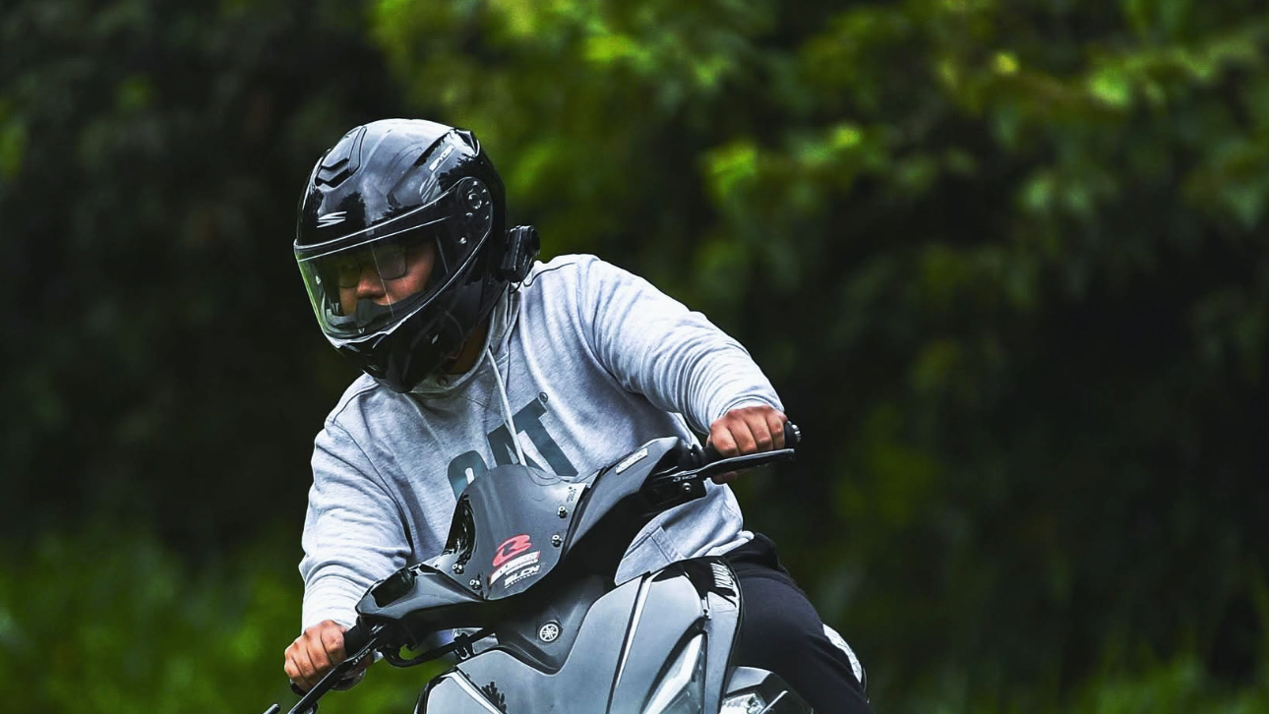
Keynesrobie Raissen Cuizon
Content Creation

Slide 2
Words That Can help me visualize my website
Motorcycle
Basketball
Mobile legends
Responsibilities
Side quests
Ambition
Flying
Riding
Doing new things
Adventure
Computer engineering
DYCI
Nature Photos
Motorcycle Repair
Hustle

Slide 3
Primary and secondary Content
Primary Content | Secondary content
Motorcycle | Motorcycle repair Parts Rides
Gaming | Mobile legends Esports Competetive scene
Life lessons | Responsibilities Side hustles
Travelling | Japan, New Zealand, Hongkong, Australia, Taiwan, Boracay, Palawan, Bicol
Food | Adobo, Bicol Express, Bistek, Pares, Tapsilog

